Slide 1
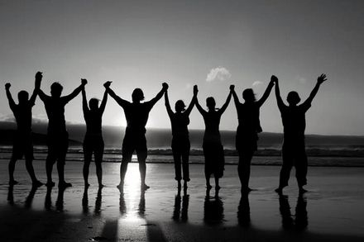
Be Affirmed
2 Thessalonians
Dr. Rick Griffith • Crossroads International Church Singapore
BibleStudyDownloads.org

Slide 2
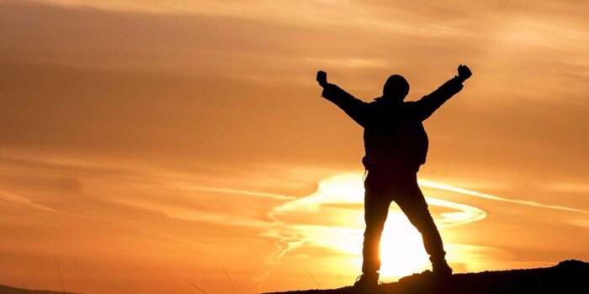
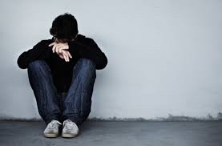
Affirmation
Notes:
Lately I have been thinking a lot about how we all need to be affirmed.
The past two weeks both Susan and I have had the most health issues ever in our 35-year marriage. Last Sunday was the first time we both ever missed church. My voice just wasn’t in shape to preach, I didn’t have the energy, etc. I won’t give you all the details lest it become “an organ recital.”
That’s not what is important. What is more significant is that some of you reached out to us and genuinely affirmed us! Thank you! Susan’s eye operation to correct her double vision did happen and was a success, despite our doubts about it going through with her rapid heartbeat days before the operation. Now, instead of seeing two husbands with her double vision, she is back to having only one husband.

Slide 3
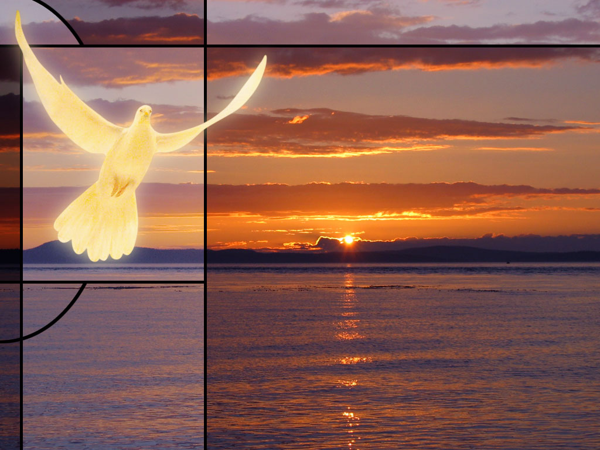
Our Mission
The mission of Crossroads is to reach the nations by reaching internationals residing in Singapore
Notes:
Let’s read this together…

Slide 4
Our Vision
The vision of Crossroads is to lead internationals into a vital relationship with Jesus Christ as disciples who can transform their unique spheres of influence (2 Tim. 2:2). In particular, Crossroads focuses primarily, but not exclusively, on reaching the English-speaking community
Notes:
4
Reading together again…

Slide 5
Our Priorities
Love the Nations
Love the Church
Love God
Notes:
Essentially our chief priorities all revolve around love—to…
• Love God first and foremost, then…
• Love the church, resulting in…
• Love the nations

Slide 6
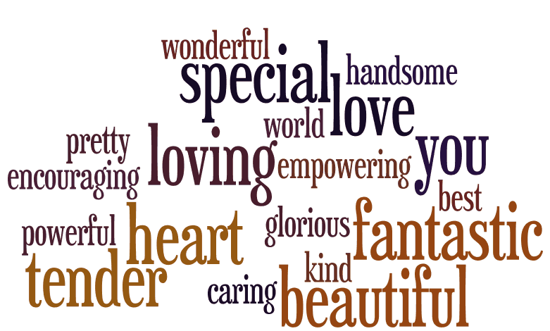
Words can affirm
Notes:
Curious about this concept of affirmation, I began looking up the word “affirmation” on Google to see what I could find.

Slide 7
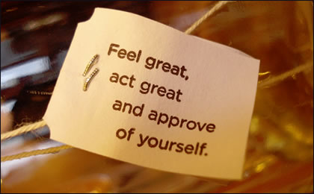
Self Affirmation
Notes:
Hmmmm, should we approve of everything we do?

Slide 8
Self Affirmation
Notes:
We are told to recite 1000 self-confidence affirmations!

Slide 9
Self Affirmation
Notes:
Some self affirming claims include “I love me.”
Also, I believe in me.

Slide 10
Self Affirmation
Notes:
How about “I am enough.”
Not to be outdone, another has modified it: “I am MORE THAN enough.”
Or I fill me mind with positive thoughts.

Slide 11
Is self affirmation enough?
Notes:
Does self affirmation really work?

Slide 12
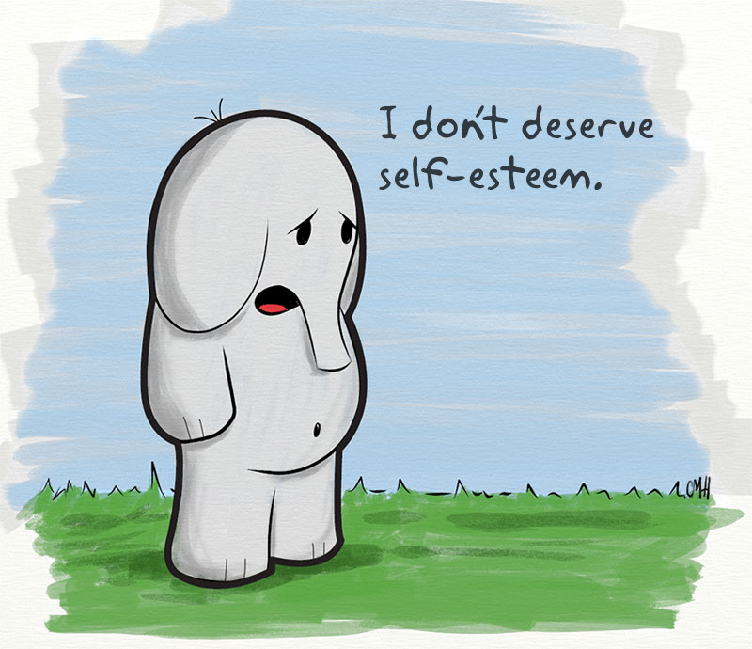
I don’t deserve self-esteem
Notes:
What if a person doubts that he or she deserves self-esteem?

Slide 13
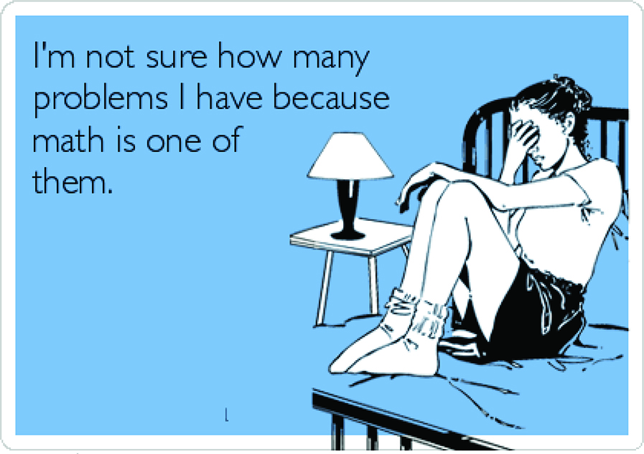
I’m not sure how many problems I have because math is one of them.
Notes:
What do you do if you say, “I am not sure how many problems I have because math is one of them”?
Isn’t it far better for others to praise you than for you to praise yourself?

Slide 14
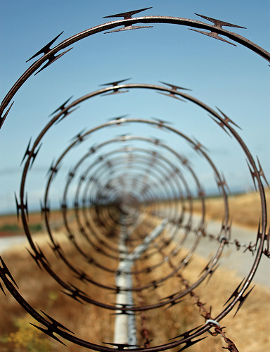
How many of us notice when others are caught in a spiral?
Notes:
Love means seeing needs. I wonder how many of us have eyes to see when others have genuine needs—physical issues are easier to see, but spiritual needs are a greater challenge.
Life goes so fast, often it’s tough to take care of outselves let alone others. I struggle with this—don’t you? Do you struggle with how to help those who are in tough straits? Do you know anyone afflicted in their relationship with their spouse, in financial woe, struggling with children or work or something else?

Slide 15
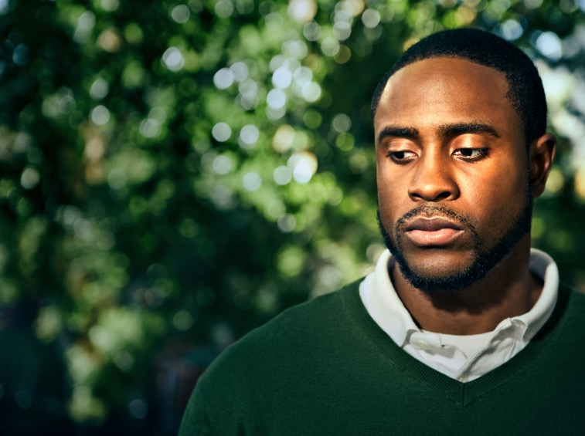
How can you help those going through tough times?
Notes:
How can you help those who are going through tough times? What should you say to ease the pain rather than add to it like Job’s counselors? What do you do to help people in difficulty?

Slide 16
How does God affirm us when we face tough times?
Notes:
Perhaps it’s even better to see how God affirms you and tells you how valuable you are to him? Do you see him affirming you?

Slide 17
Background to 2 Thessalonians
Notes:
Today we will look at a church caught in the “winepress of persecution” that had yielded to God, resulting in a fragrant display of God’s grace. The Thessalonians still had “persecutions and trials” about a year after Paul had established the church but they were bearing under it, though crushed.

Slide 18
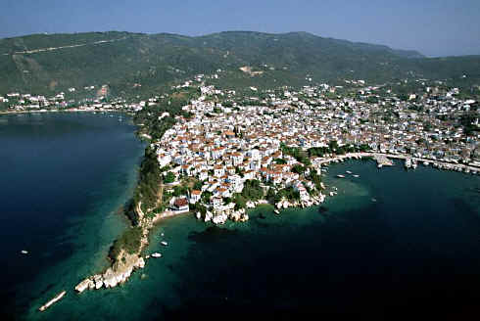
Port city at the Thermaic Gulf
Notes:
The church was located in northern Greece on a peninsula as both a key port city…

Slide 19
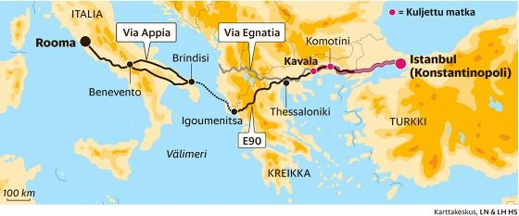
Port city at the Thermaic Gulf
Knitted together 26 villages
Main seaport and naval base of Macedonia
Major gateway into Macedonia via port and Via Egnatia.
The Egnatian Way (Via Egnatia) ran through the city NW to SE
- Major land route across the region
- extended for 493 miles [790 km]
Notes:
…and also on the main east-west land route in the Roman Empire called the Via Egnatia.

Slide 20
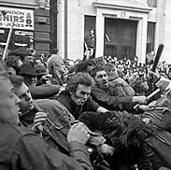
Throw him
in jail!
Down with
Paul!
What to do?...
Notes:
Paul established the Thessalonian church amidst great difficulty. The background is in Acts 17.

Slide 21
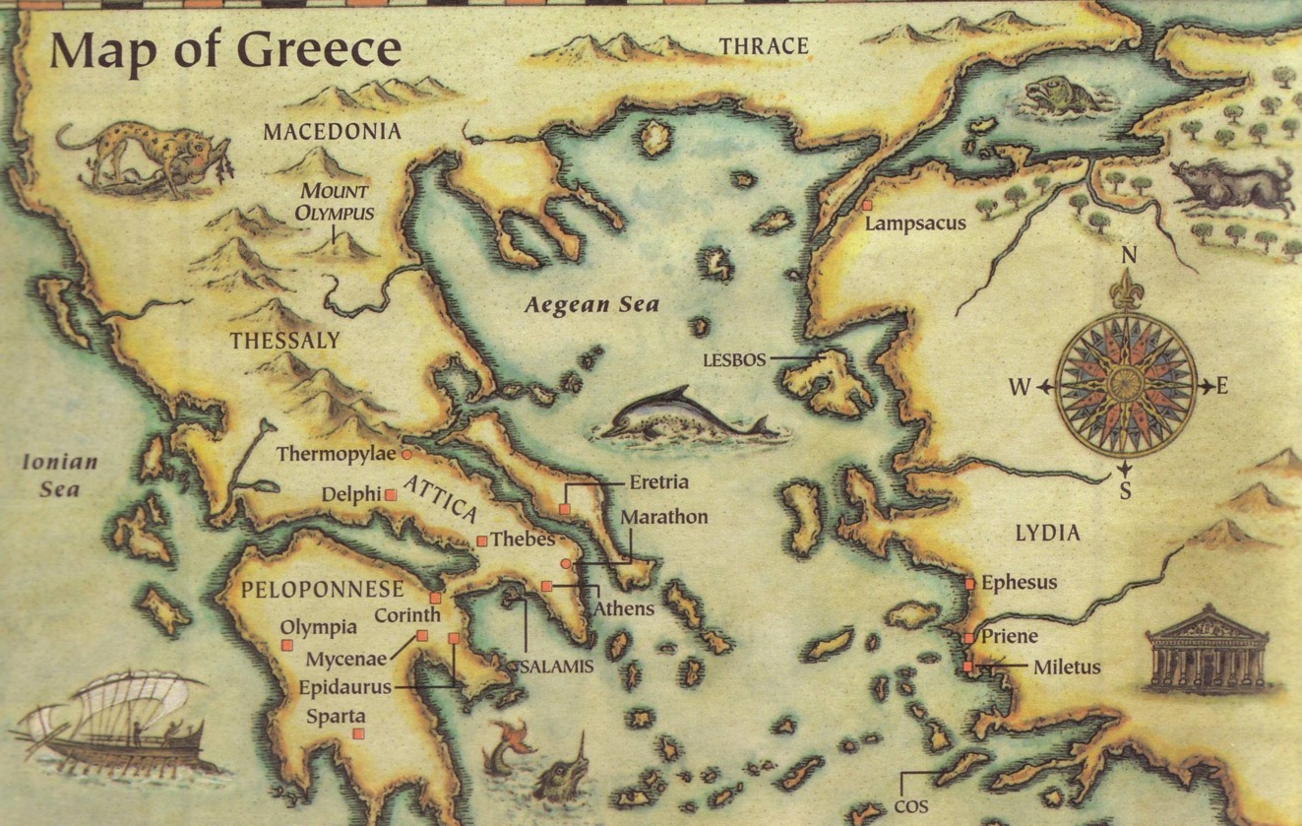
This epistle was written in AD 51
Thessalonica
Berea
Athens
Corinth
Three ways we can encourage others...
Written in Corinth after hearing Tim's report
Notes:
Paul only stayed there about three months, but the Jews who kicked him out over to Berea even followed him to Berea and kicked him out of there too!

Slide 22
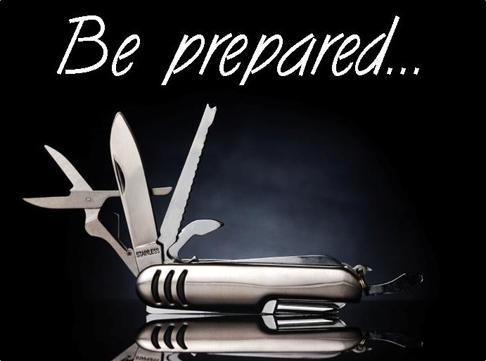
Be Prepared
1 Thessalonians
Dr. Rick Griffith • Crossroads International Church Singapore
BibleStudyDownloads.org

Slide 23
Our Need
1 Thessalonians
Notes:
At some point in perhaps the not-too-distant future millions of people will just quickly rise to meet the Lord Jesus Christ.

Slide 24
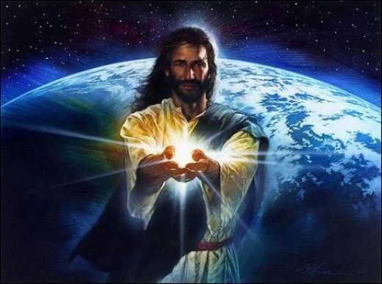
Black

Slide 25
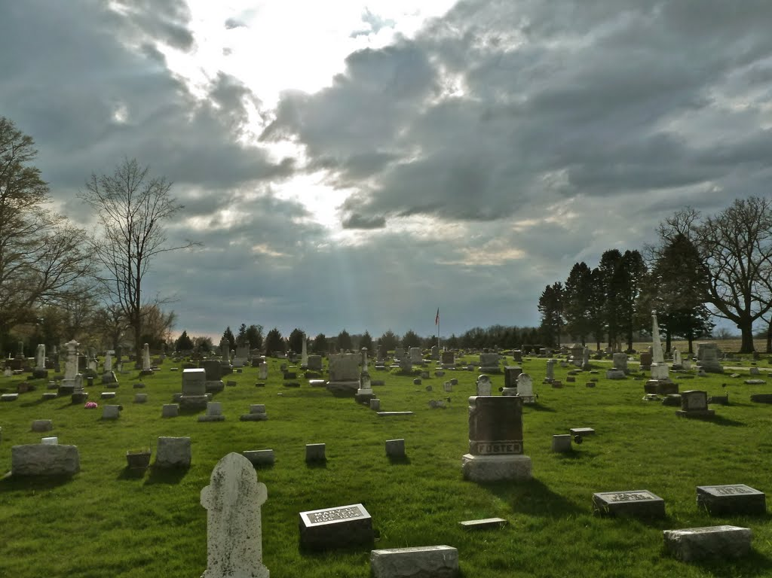
The Rapture
"And now, dear brothers and sisters, we want you to know what will happen to the believers who have died so you will not grieve like people who have no hope. ¹⁴For since we believe that Jesus died and was raised to life again, we also believe that when Jesus returns, God will bring back with him the believers who have died" (1 Thess. 4:13-14 NLT).
Notes:
Paul speaks clearly of this next event on God’s prophetic calendar in 1 Thess 4:13-18…

Slide 26
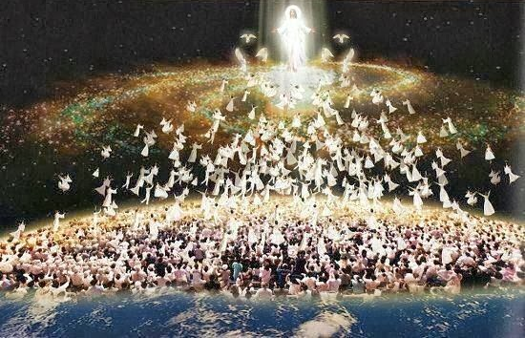
The Rapture
"For the Lord himself will come down from heaven with a commanding shout, with the voice of the archangel, and with the trumpet call of God. First, the Christians who have died will rise from their graves. ¹⁷Then, together with them, we who are still alive and remain on the earth will be caught up in the clouds to meet the Lord in the air. Then we will be with the Lord forever. ¹⁸So encourage each other with these words" (1 Thess. 4:16-18 NLT).

Slide 27
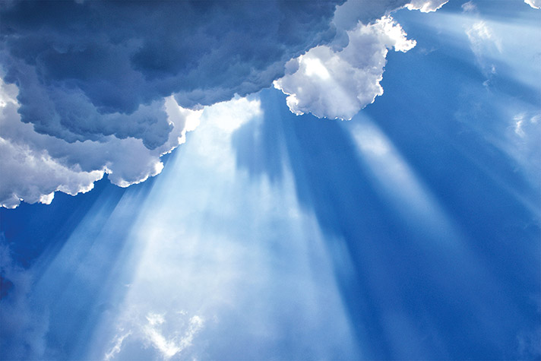
How can you be prepared for the Rapture?
2 ways…
1 Thessalonians
Notes:
What specific ways can you be ready for Jesus when he come back?

Slide 28
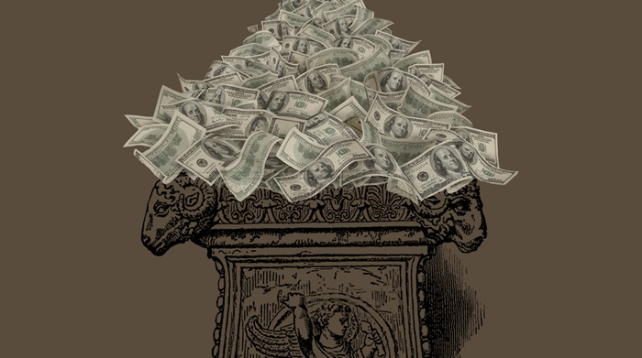
I. Serve Jesus without greed (Chapters 1–3).
1 Thessalonians
Notes:
Live for Christ as if money is not a big concern.

Slide 29
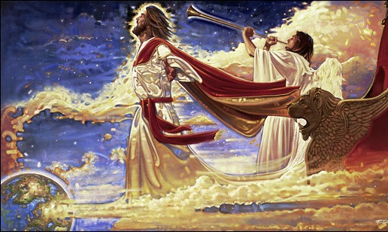
II. Care about both people and theology (Chapters 4–5).
+
1 Thessalonians
Notes:
Doctrine and relationships should occupy much of our time.
In particular, we need a theology of Christ’s second coming.

Slide 30
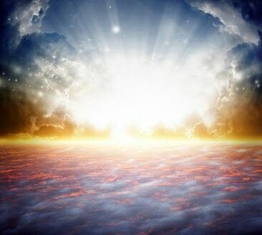
Main Idea
Be prepared for Christ’s return with your money, friends and Bible.
1 Thessalonians

Slide 31
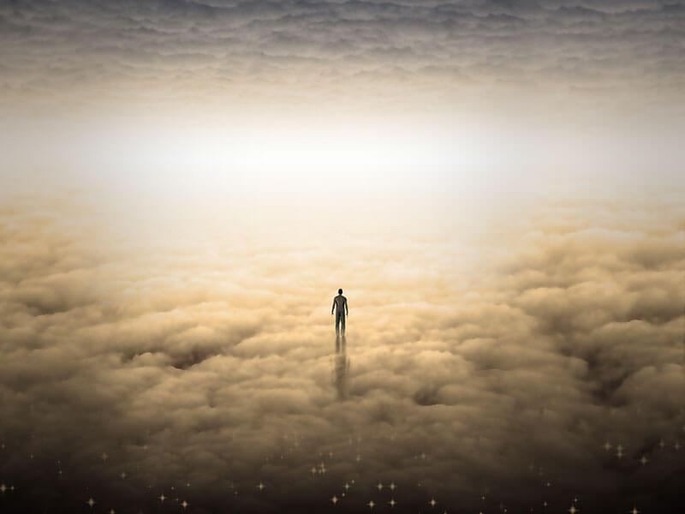
We will all give an account
1 Thessalonians

Slide 32
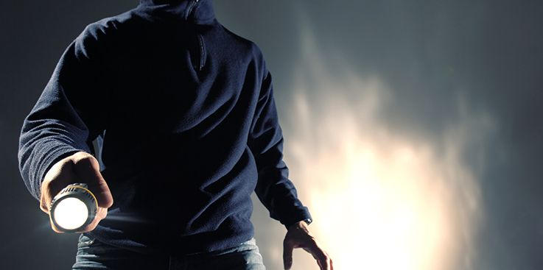
1 Thessalonians 5:2
"like a thief in the night"
Notes:
Do you think your home will be broken into tonight? At his return, Jesus will be as expected as much as you expect a thief to rob your house tonight.
Are you prepared for him to arrive at any time? Is there anything you do that will cause you to be ashamed if he came at that time you do it?

Slide 33
NT Overview (Paul's Letters)
38 124 39-41
"To the remotest part of the earth" (Acts 1:8)
Acts 9 13 14 15 16 18 21 27 28
Apr 48- Sep 49
1 Galatia
Apr 50- Sep 52
2 Aegean
Spr 53- May 57
3 Asia
Feb 60- Mar 62
1 Rome
Spr 62- Fall 67
4 Spain
Aut 67- Spr 68
2 Rome
Summer 35- 37
Damascus Antioch
May 57- Aug 59
Trials
Fall 49
The
Council
Spring 68
Expansion of Church
35 48 49 50 52 53 57 60 62 67 68 95
Matt
Luke
Acts
Mark
John
Gal
1 Thess
2 Thess
Gospels & Acts
Pauline Epistles
1234
Journeys
Rome
Imprisonments
Pauline
Notes:
Even after Paul left, things didn’t get much better. He had already written 1 Thessalonians probably only months before, telling them to continue in a holy lifestyle as they awaited the return of Christ amidst their trials.

Slide 34
1-2 Thessalonians
Macedonia
212
Thessalonica
Corinth
Notes:
But now, months later, Jesus had not come and the church was wondering if they had already entered the tribulation. So Paul wrote them another letter to show how God continued to affirm them.

Slide 35
Argument
214
Paul wrote 2 Thessalonians to help the believers handle three difficulties facing the church:
Increased persecution (1:3-10),
False teaching that the day of the Lord had already come (2:1-12), and
Idleness in some lazy Thessalonian Christians who were "waiting for the rapture" (3:6-15).
Paul wrote to encourage perseverance based upon their future reward at the day of the Lord (ch. 1) and to correct their false notion of the day of the Lord (ch. 2) so he exhorted discipline instead of idleness (ch. 3). The key theme is the day of the Lord and its implications on behavior.

Slide 36
How does God affirm us when we face tough times?
3 ways…

Slide 37
Slides on 2 Thessalonians 1

Slide 38
Outline of 2 Thessalonians
How God affirms…
Emotions
1

Slide 39
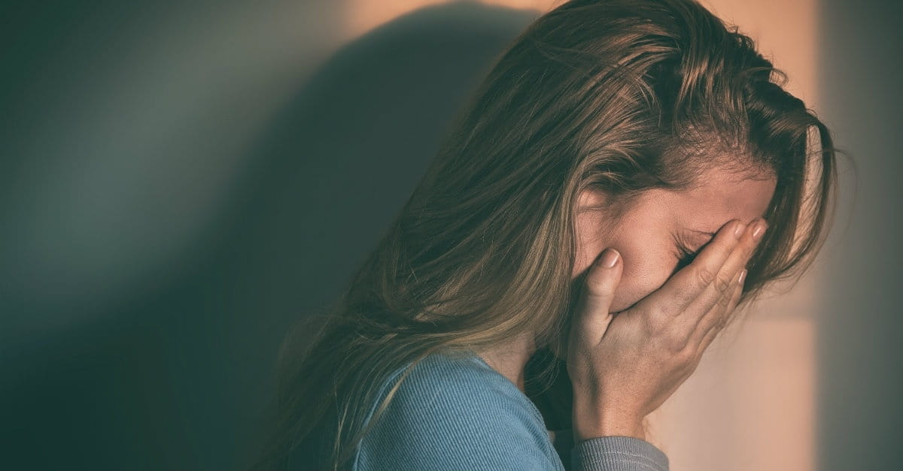
I. Emotionally: God gives perseverance to bring maturity (2 Thess 1).
Notes:
The Lord helps us not to lose heart so we will grow.
Paul mentions his fellow-workers Silas and Timothy but not his position as an apostle to begin his letter relationally (1:1-2).

Slide 40
Paul's Advice to Troubled Thessalonians: Focus on God!
215
Focus on God in the Thessalonian Epistles
Total Verses | "God" | "Lord" | "Jesus" | "Christ" | Total
1 Thess. (89) | 36 | 24 | 16 | 10 | 86
2 Thess. (47) | 18 | 22 | 13 | 10 | 63
Total (136) | 54 | 46 | 29 | 20 | 149
Number of Greek occurrences from Elwell & Yarbrough, Encountering the New Testament, 332
Notes:
Amazingly, 1-2 Thessalonians has 136 verses but mentions God 149 times!

Slide 41
MAIN IDEA OF MATTHEW
Serve the Lord Jesus Christ
GOD
Lord
KING
Jesus
Christ
SAVIOR
Notes:
Serve Jesus as Savior, God, and King of your life!
One core value of our church is to be context-relevant. We present the unchanging Lord Jesus Christ to our ever-changing world because no one is more relevant than him. How do we do this? We proclaim that he is the ultimate authority as God (Lord), yet took on humanity to save us from our sins (Jesus) and will rule over all (Christ).

Slide 42
A Worthy Name to Repeat
2 Thess 1
2 Thess 2
2 Thess 3
Lord Jesus Christ (1:1)
Lord Jesus Christ (2:1)
Lord Jesus Christ (3:6)
Lord Jesus Christ (1:2)
Lord Jesus Christ (2:14)
Lord Jesus Christ (3:12)
Lord Jesus Christ (1:12)
Lord Jesus Christ (2:16)
Lord Jesus Christ (3:18)
Notes:
The lofty name of the “Lord Jesus Christ” appears 9 times in this book—three times each in all three chapters (NLT):
2Th. 1:1 This letter is from Paul, Silas, and Timothy. We are writing to the church in Thessalonica, to you who belong to God our Father and the Lord Jesus Christ.
2Th. 1:2 May God our Father and the Lord Jesus Christ give you grace and peace.
2Th. 1:12 Then the name of our Lord Jesus will be honored because of the way you live, and you will be honored along with him. This is all made possible because of the grace of our God and Lord, Jesus Christ.
2Th. 2:1 Now, dear brothers and sisters, let us clarify some things about the coming of our Lord Jesus Christ and how we will be gathered to meet him.
2Th. 2:14 He called you to salvation when we told you the Good News; now you can share in the glory of our Lord Jesus Christ.
2Th. 2:16 Now may our Lord Jesus Christ himself and God our Father, who loved us and by his grace gave us eternal comfort and a wonderful hope,
2Th. 3:6 And now, dear brothers and sisters, we give you this command in the name of our Lord Jesus Christ: Stay away from all believers who live idle lives and don’t follow the tradition they received from us.
2Th. 3:12 We command such people and urge them in the name of the Lord Jesus Christ to settle down and work to earn their own living.
2Th. 3:18 May the grace of our Lord Jesus Christ be with you all.

Slide 43
See God's perspective on trials (1:1-2).
Notes:
So these first two verses show that seeing God's perspective helps us to reach out and affirm others. There’s another way to affirm others in verse 3…

Slide 44
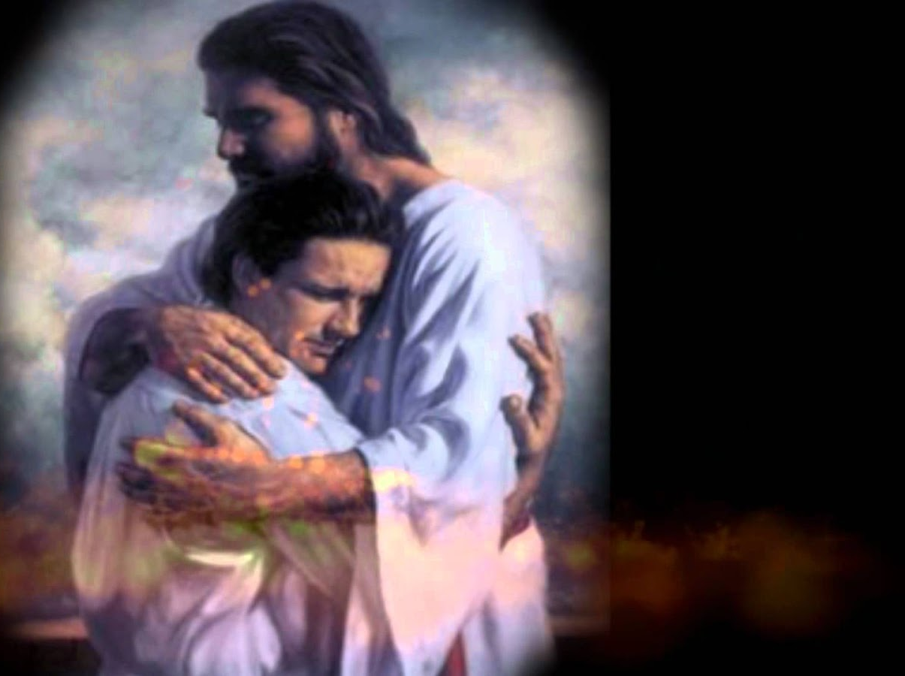
"This letter is from Paul, Silas, and Timothy. We are writing to the church in Thessalonica, to you who belong to God our Father and the Lord Jesus Christ. ²May God our Father and the Lord Jesus Christ give you grace and peace."
2 Thessalonians 1:1-2 NLT
Notes:
You may be wondering why I say that these verses teach us to help afflicted people see God's perspective. Aren't they just the preliminaries to the letter that follows?
Yes, but notice how many times Paul mentions God in this one sentence—four times!
Twice he refers to the Father and twice to Christ, who is placed on equal level with the Father since He, too, is God.

Slide 45
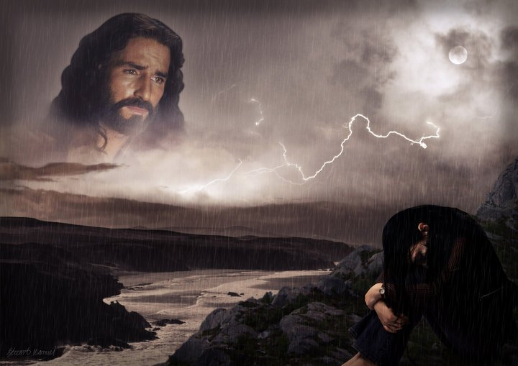
"By looking to our lofty Lord Jesus Christ we realize that He is not looking away from us in complacency but looking down on us in compassion."
—Charles R. Swindoll, Steadfast Christianity, 4—
Notes:
We all have peaks and valleys in our lives—peaks when it's easy to see the Lord and valleys when it's difficult to see Him. Swindoll writes…
• Text above

Slide 46
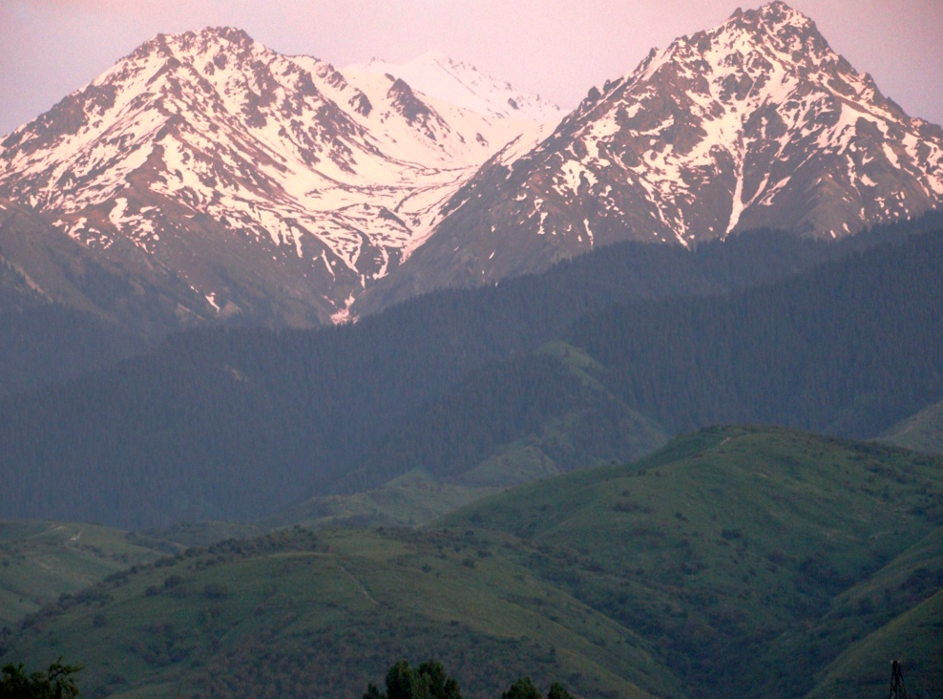
"I will lift up my eyes to the mountains; From [where else] shall my help come? My help comes from the LORD, who made heaven and earth (Ps. 121:1-2)."
—Charles R. Swindoll, Steadfast Christianity, 4—

Slide 47
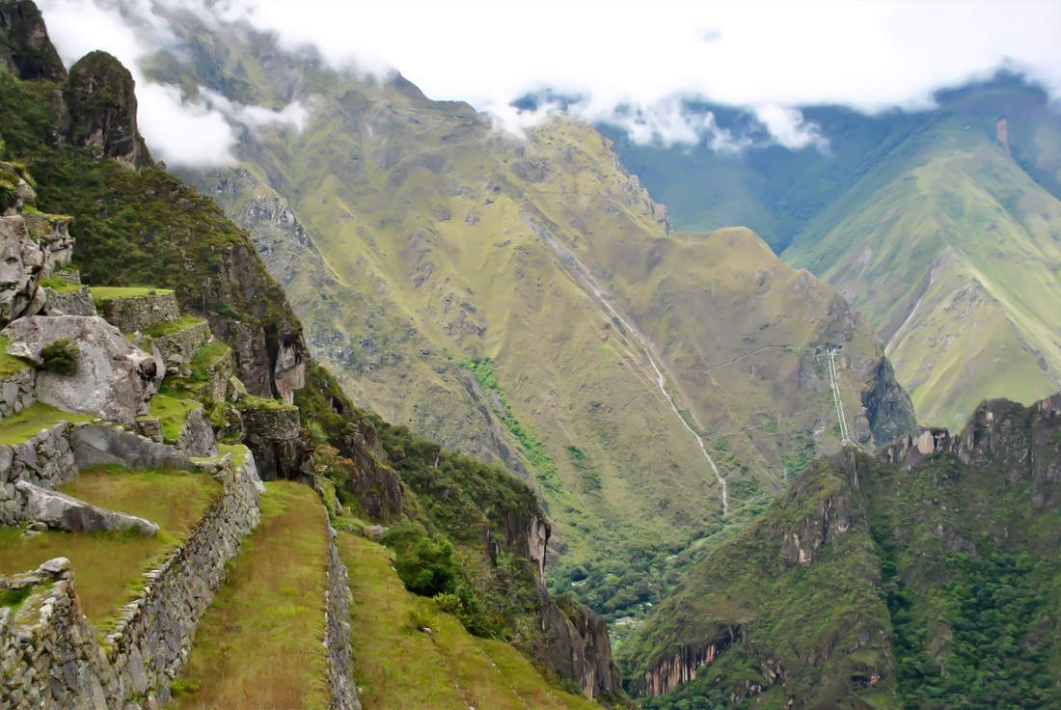
"Do you look to the peaks when you're in the valleys? Or are you so rutted in the valleys that you've forgotten the mountains are even there? People who fail to affirm usually do so because they fail to see the Lord in the midst of it all."
—Charles R. Swindoll, Steadfast Christianity, 4—

Slide 48
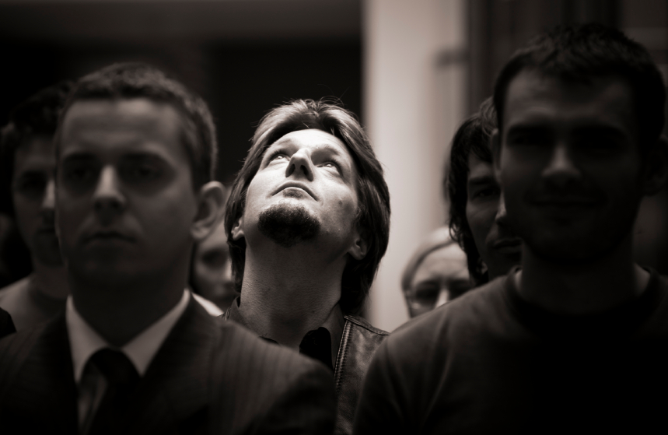
"When we look up, we are reminded that God is not removed… not absent… not out of touch. And then we get a glimpse of the divine perspective on our circumstances—which can only be seen from the peaks, not in the valleys."
—Charles R. Swindoll, Steadfast Christianity, 4—

Slide 49
Seeing from God's Perspective
Notes:
Aren't you encouraged when you're around people who always talk about the Lord?
They see life from God's viewpoint—and there's no more encouraging view!

Slide 50
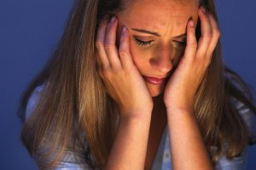
We also need to help others focus on the Lord in their difficulty

Slide 51
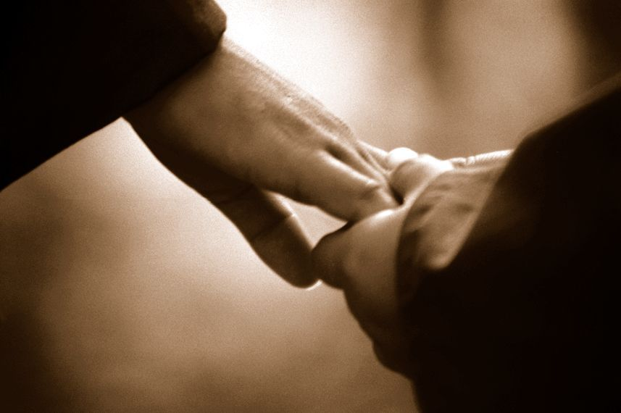
Turn others to the Lord
By saying nothing at all
By sharing a Bible reference
Notes:
There are ways of turning people's sights to the Lord without always quoting Scripture and saying, "Praise Jesus, Praise Jesus…"
• Sometimes we affirm and turn others to God by saying nothing at all.
• Often just writing down a Scripture reference for the person and encouraging him to look it up later is best.

Slide 52
Thank God for others' growth (1:3).
Notes:
Others benefit in their spiritual walk when they hear you praise God for them.

Slide 53
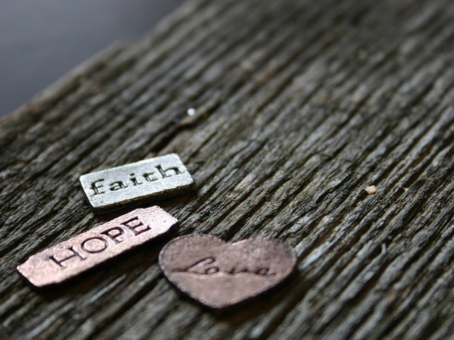
"Dear brothers and sisters, we can't help but thank God for you, because your faith is flourishing and your love for one another is growing” (2 Thessalonians 1:3 NLT).
Notes:
Paul thanked God for two things—their faith and their love (1:3).
I wonder how often you thank God for others’ spiritual growth. When someone is going through trials how do we generally pray?
I hate to admit it, but most of the time we ask God to remove the trials.
Notice the focus of Paul's prayer here—not a request that God take away their trials but thanksgiving!
He affirmed them by praying not for the removal of the trial but for character development through the trial.
Paul doesn't focus on what's going on around them—he looks at what God is doing within them—building qualities like faith, love, and perseverance mentioned in verse 4.

Slide 54
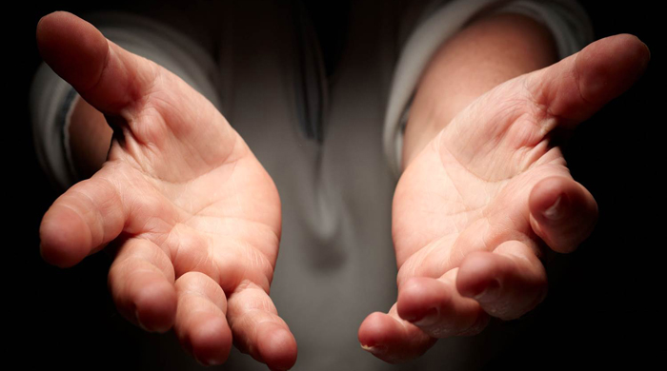
He affirmed them that their love for one another kept increasing—so we see Paul affirming their affirmation!

Slide 55
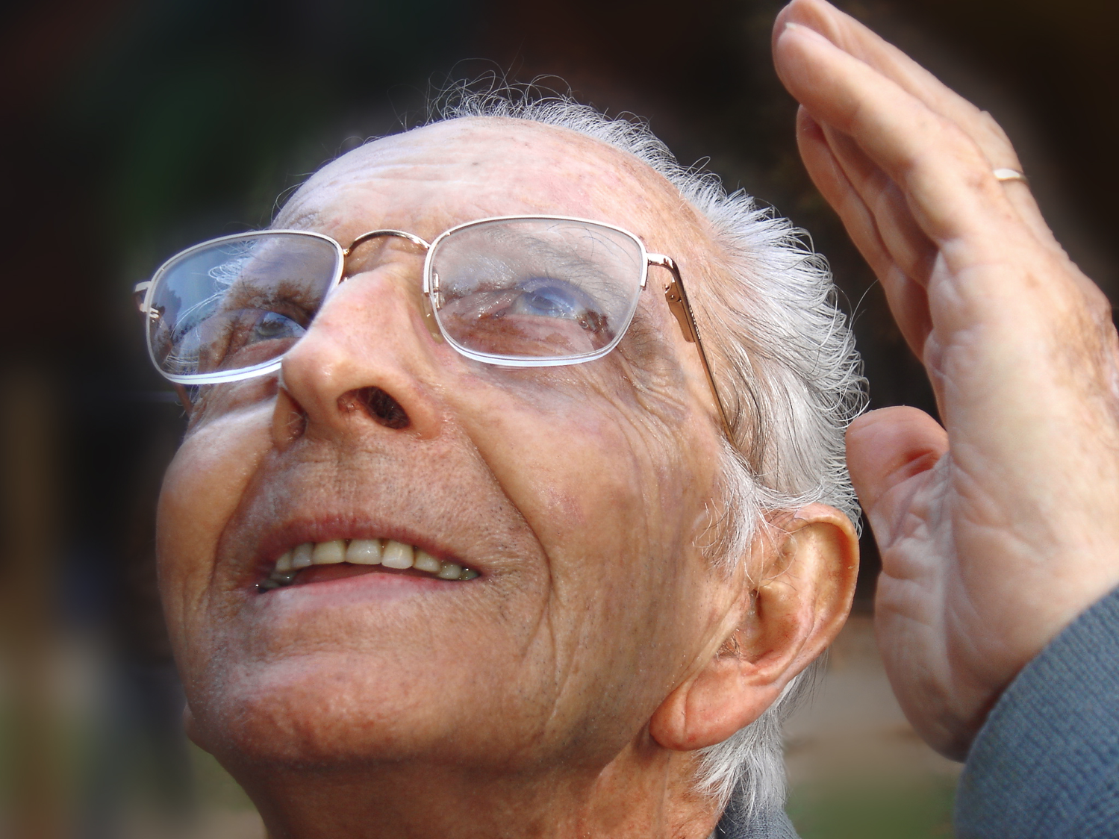
Prayer Affirms
Notes:
Prayer for others is no doubt the best way to affirm others. That's why Paul did it!
I hope as a church we’ll grow to pray beyond a focus on the circumstances and pray that God will use difficulties to build the character of Christ within us.
The three qualities Paul notes are a great starting place—faith, love and perseverance.
MPI
I think our prayer times together as a church would be even better if we make it a point to thank God for others' growth right there in the group.

Slide 56
Publicly brag about others' spiritual growth (1:4).
Notes:
Make your praise common knowledge to help others persevere.

Slide 57
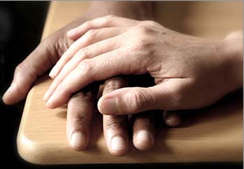
"We proudly tell God's other churches about your endurance and faithfulness in all the persecutions and hardships you are suffering."
2 Thessalonians 1:4 NLT
Notes:
Paul told others how well they hung in there (1:4).
He could have been negative—“Man, you should see those Thessalonians’ hassles. Their theology is messed up so much they think they’re in the Tribulation!”
Not Paul! He said, "Wow! You should see how the church at Thessalonica continues to reach out, deepen in their love, make great strides in trusting God, and endure—despite the most intense persecutions in the Roman Empire. They're doing grrrrrrrreat!"

Slide 58
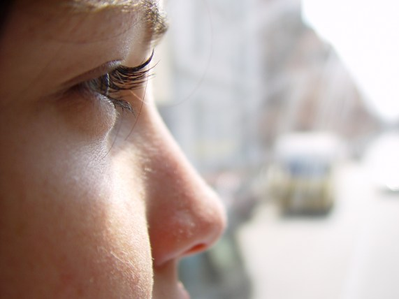
People often become what you tell them they will become.
Notes:
People often become what you tell them they will become.
This is especially true in parenting children.
The important principle here is that people will become what you tell them they will become. This is especially true in parenting children.

Slide 59
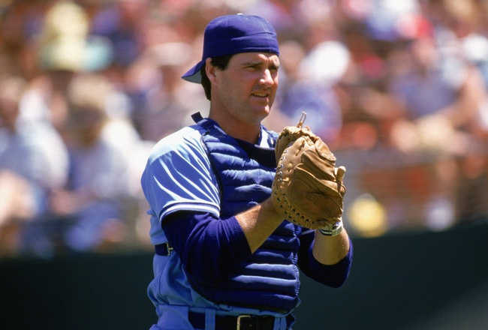
Jim Sundberg
Notes:
Children tend to become what their parents tell them they will become. Major league baseball catcher Jim Sundberg said that his father was always telling Jim, “Jim, one day you’re going to be a great major league catcher.”

Slide 60
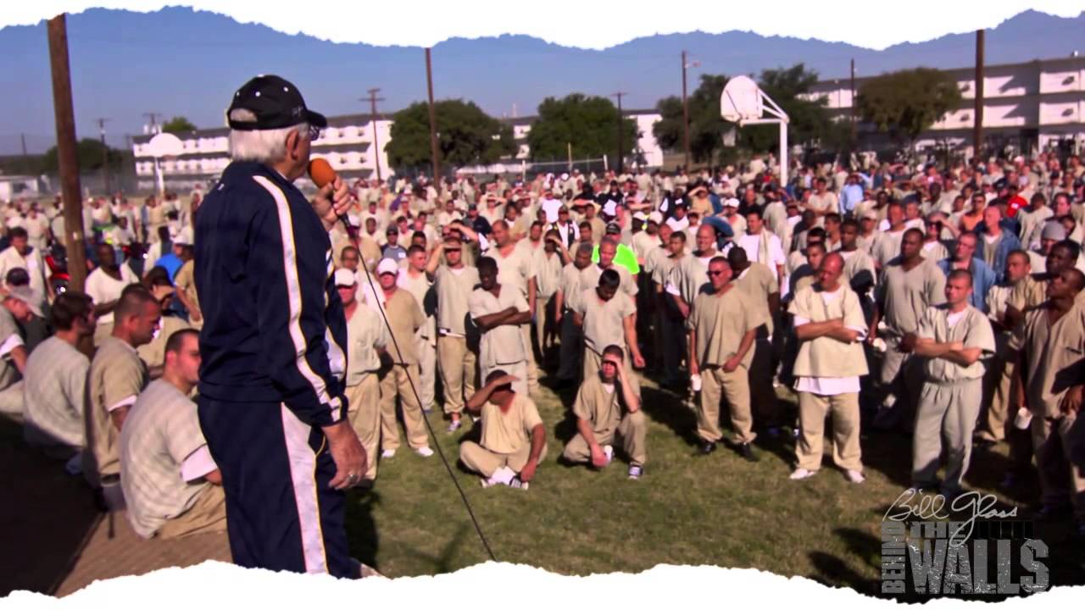
"How many of you had parents that told you that you would end up in prison one day?”
Notes:
Evangelist Bill Glass asked a group of 1000 inmates, “How many of you had parents that told you that you would end up in prison one day?” Almost every one of the inmates raised their hands.

Slide 61
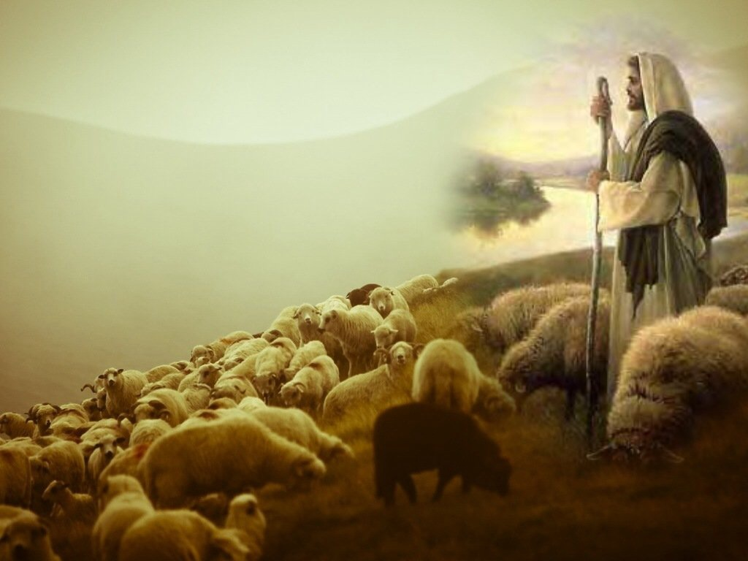
Affirm the afflicted to help them mature in Christ.
Main Idea of 2 Thess 1:1-4
Notes:
Encourge others to grow!

Slide 62
"And God will use this persecution to show his justice and to make you worthy of his Kingdom, for which you are suffering. ⁶In his justice he will pay back those who persecute you" (2 Thess 1:5-6 NLT).
Notes:
God will reward the church’s perseverance during affliction but punish their persecutors by helping the church become mature (1:3-12).

Slide 63
"And God will provide rest for you who are being persecuted and also for us when the Lord Jesus appears from heaven. He will come with his mighty angels, ⁸in flaming fire, bringing judgment on those who don’t know God and on those who refuse to obey the Good News of our Lord Jesus" (2 Thess 1:7-8 NLT).

Slide 64
"They will be punished with eternal destruction, forever separated from the Lord and from his glorious power. ¹⁰When he comes on that day, he will receive glory from his holy people—praise from all who believe. And this includes you, for you believed what we told you about him" (2 Thess 1:9-10 NLT).

Slide 65
So we keep on praying for you, asking our God to enable you to live a life worthy of his call. May he give you the power to accomplish all the good things your faith prompts you to do.
2 Thess 1:11

Slide 66
Then the name of our Lord Jesus will be honored because of the way you live, and you will be honored along with him. This is all made possible because of the grace of our God and Lord, Jesus Christ.
2 Thess 1:12

Slide 67
Persevering through affliction develops maturity
Charles R. Swindoll, Steadfast Christianity, 3

Slide 68
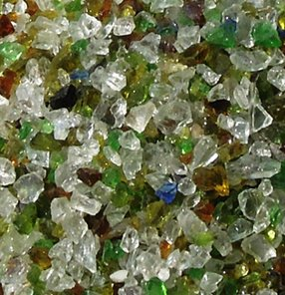
Marbles or Grapes?
Notes:
We decide how difficulties will change us. Do you agree? In his book No Greater Power, Richard C. Halverson, past chaplain of the US Senate, wrote:
“Crush marbles and you get fragmentation, disintegration—hard, sharp pieces. You can get hurt if you’re not careful.
Crush grapes and you get fragrant, refreshing wine.
Some people relate like marbles. The fear of vulnerability hardens them. They protect themselves, allow no one to penetrate. Being vulnerable is high-risk, and they want low-risk. They bump against others and ricochet around, never enjoying a vital relationship. In brittle lovelessness, they shatter when crushed, and hurt others.
Some people relate like grapes. They yield to pressure. They accept their weakness as essential to intimacy. They give love, knowing love is always vulnerable, knowing love is the heart and soul of our faith. When crushed, they bring blessing: fragrant, redemptive blessing.”
Difficulties certainly come our way for every one of us.
But how do you respond to these trials? Are you like a marble or like a grape? In either case, we get crushed, but marbles resist it while grapes welcome the benefits.
Are you angry at God for allowing difficulty into your life? Or do you see him affirming you?
Richard C. Halverson, No Greater Power (Portland, OR: Multnomah, 1986), 67; cited in Charles R. Swindoll, Steadfast Christianity: A Study of Second Thessalonians (Fullerton, CA: Insight for Living, 1986), 1.

Slide 69
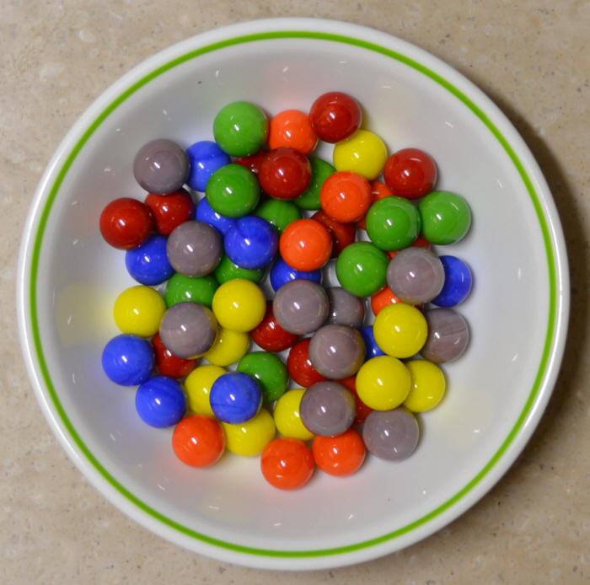
My Defensiveness
Notes:
I have needed affirmation to overcome my own weakness of defensiveness.
As I have recently reflected on my early years as a Christian teenager, I recall one particular weakness. When someone expressed a concern about me, I reacted with defensiveness. This was a problem I had in my early years of marriage too. Susan would observe a weakness in me and I would defend myself as if she was attacking me.
After further consideration and prayer about this, I realized that it went back to my teenage years. My mother married a third time when I was age 13, and my step-father would point out a deficiency in me rather roughly. He had a horrible relationship with his own father—so much that he called him by his first name rather than “Dad” or “Father”—and he lacked an ability to gently tell me how to better sweep the floor or wash the dishes or whatever. I constantly felt attacked, even though that wasn’t his intention.
So I developed this defensive attitude in my other relationships too. I suspect I felt that way about God as well.
God really changed me, though. At least I think he did! I guess you can be the judge whether I defend myself right now. I think he has given me an ability to respond rather than react, to persevere in a way that helps me grow in maturity.

Slide 70
How does God affirm us when we face tough times?

Slide 71
I. Emotionally: God gives perseverance to bring maturity (2 Thess 1).
Notes:
The Lord helps us not to lose heart so we will grow.]

Slide 72
Slides on 2 Thessalonians 2

Slide 73
Outline of 2 Thessalonians
How God affirms…
Emotions
1
Theology
2
Notes:
II. Theologically: God gives us truth to bring stability (2 Thess 2).
[Theology matters! The Lord corrects our misconceptions to give us firm footing.]

Slide 74
II. Theologically: God gives us truth to bring stability (2 Thess 2).
Notes:
Theology matters! The Lord corrects our misconceptions to give us firm footing.

Slide 75
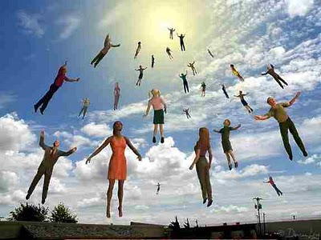
"Now, dear brothers and sisters, let us clarify some things about the coming of our Lord Jesus Christ and how we will be gathered to meet him" (2 Thess 2:1 NLT).

Slide 76
Key Verse
211
"Don’t be so easily shaken or alarmed by those who say that the day of the Lord has already begun. Don’t believe them, even if they claim to have had a spiritual vision, a revelation, or a letter supposedly from us" (2 Thess 2:2 NLT).
2 Thessalonians

Slide 77
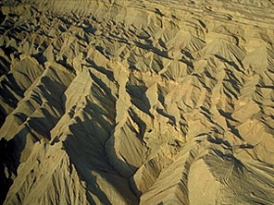
Judgment!
216
followed by…

Slide 78
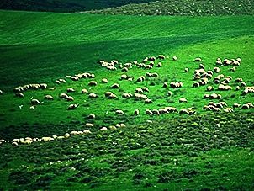
Blessing!
216

Slide 79
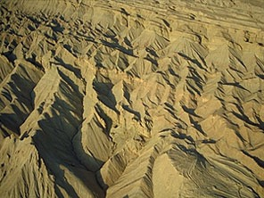
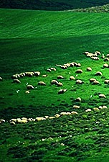
The Day of the LORD
216
Judgment
+
Blessing
Tribulation
Millennium
Rev. 6–19
Rev. 20
7 years
1000 years

Slide 80
A Dispensational Timeline
437
Great
White
Throne
(Rev. 20:11-14)
Rapture (1 Thess. 4:13-18)
2nd Advent
(Zech. 14:3-5)
Day of the LORD
Church Age
Tribulation
(1 Thess. 5)
Millennium
(Zech. 14:6-21)
Notes:
80
But the situation at Thessalonica still didn’t change—so much so that many in the church thought they were in the Great Tribulation. The persecution hadn't let up so he wrote them to affirm them for their steadfastness.

Slide 81
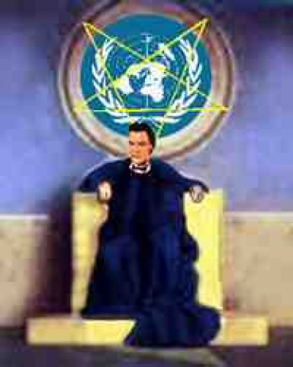
Antichrist Sets Up Image for Worship (2 Thess. 2:3-4 NLT)
80 I
"Don't be fooled by what they say. For that day will not come until there is a great rebellion against God and the man of lawlessness is revealed—the one who brings destruction. ⁴He will exalt himself and defy everything that people call god and every object of worship. He will even sit in the temple of God, claiming that he himself is God."

Slide 82
"That day will not come until…" (2:3a)
213
1. "the rebellion (apostasy) occurs" (3b)
= Christendom is completely apostate
2. "the man of lawlessness is revealed" (3c)
= Antichrist signs covenant with Israel (Dan. 9:27)
3. "the one who now holds [lawlessness] back will be taken out of the way" (7b)
= restraining influence of the Holy Spirit in the Church is taken to heaven

Slide 83
"Don’t you remember that I told you about all this when I was with you? ⁶And you know what is holding him back, for he can be revealed only when his time comes. ⁷For this lawlessness is already at work secretly, and it will remain secret until the one who is holding it back steps out of the way. ⁸Then the man of lawlessness will be revealed, but the Lord Jesus will kill him with the breath of his mouth and destroy him by the splendor of his coming" (2 Thess 2:5-8 NLT).

Slide 84
The Restrainer
209
The Spirit's restraining evil through the Church will be absent (2 Thess. 2:6-7):
⁶And now you know what is holding him back, so that he may be revealed at the proper time. ⁷For the secret power of lawlessness is already at work; but the one who now holds it back will continue to do so till he is taken out of the way (NIV).
("what restrains" = neuter, 2:6 = gospel preaching)
("he who restrains" = masculine, 2:7 = a person)
("Spirit" = neuter noun but used of a person)

Slide 85
The Day of the Lord
2 Thess. 2:3-7 Prerequisites Before Day of the Lord (3 of them):
213
1
Judgment Seat in Heaven 2 Cor. 5:10; 1 Cor. 3:10-15
3 Restrainer (2:7b)
2
1 Apostasy (2:3b)
2 Antichrist (2:3c)
3
1
Second Coming Rev. 19:11-21
Rapture 1 Thess. 4:13-18
Tribulation
Millennium
Eternal State
3
1000 yrs.
69 Weeks (Dan. 9:24-27)
Church Age Matt. 16:18 Acts 2:1-4
2
3½
3½
Rev. 20:4-6
(Timeless)
7 yrs.
(Daniel's 70th Week) Matt. 24:21
Matt. 27:50
Short Period of Preparation; Rise of the Antichrist (length of time unknown)
"Prophecy" (Dallas Seminary video series, 1980s)

Slide 86
"This man will come to do the work of Satan with counterfeit power and signs and miracles. ¹⁰He will use every kind of evil deception to fool those on their way to destruction, because they refuse to love and accept the truth that would save them. ¹¹So God will cause them to be greatly deceived, and they will believe these lies. ¹²Then they will be condemned for enjoying evil rather than believing the truth" (2 Thess 2:9-12 NLT).

Slide 87
A Huge Leadership Vacuum
216a
Difficult times always set the stage for dictators to rise to the occasion.

Slide 88
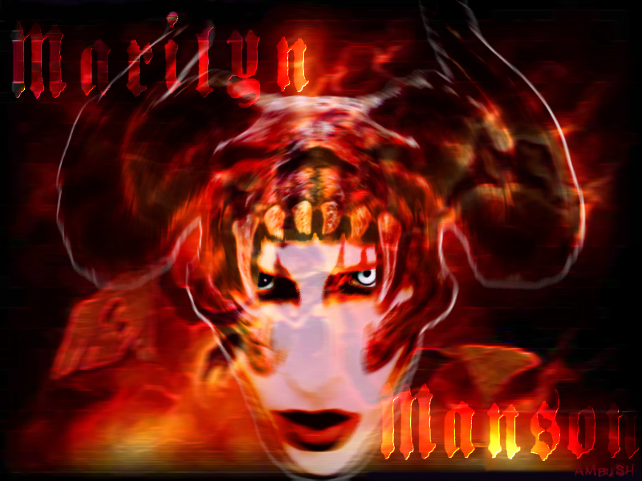
Names for the Antichrist
216a
79
Bloody & Deceitful Man (Ps 5:6)
Little Horn (Dan. 7:8)
Man of Sin
(2 Thess. 2:3)
Beast from the Sea (Rev. 13:1)
One Causing Desolation (Dan. 9:27)

Slide 89
The Activity of the Antichrist
216a
79

Slide 90
Chronology of the 70th "Week"
333
Adapted from J. Dwight Pentecost, Dallas Theological Seminary, 1988
Middle of the Week
Sign of Son of Man Matt. 24:30
Christ's Return Complete
3½ YEARS
1290 DAYS
Dan. 12:11
30 DAYS
30 DAYS
1260 DAYS
45 DAYS
Rev. 11:3; 12:6
Dan. 12:12
3½ YEARS
3½ YEARS
Election of Beast Rev. 17:13
Covenant Made Dan. 9:27a
Covenant Broken Dan. 9:27b
2nd ADVENT
The Great Tribulation
The Tribulation

Slide 91
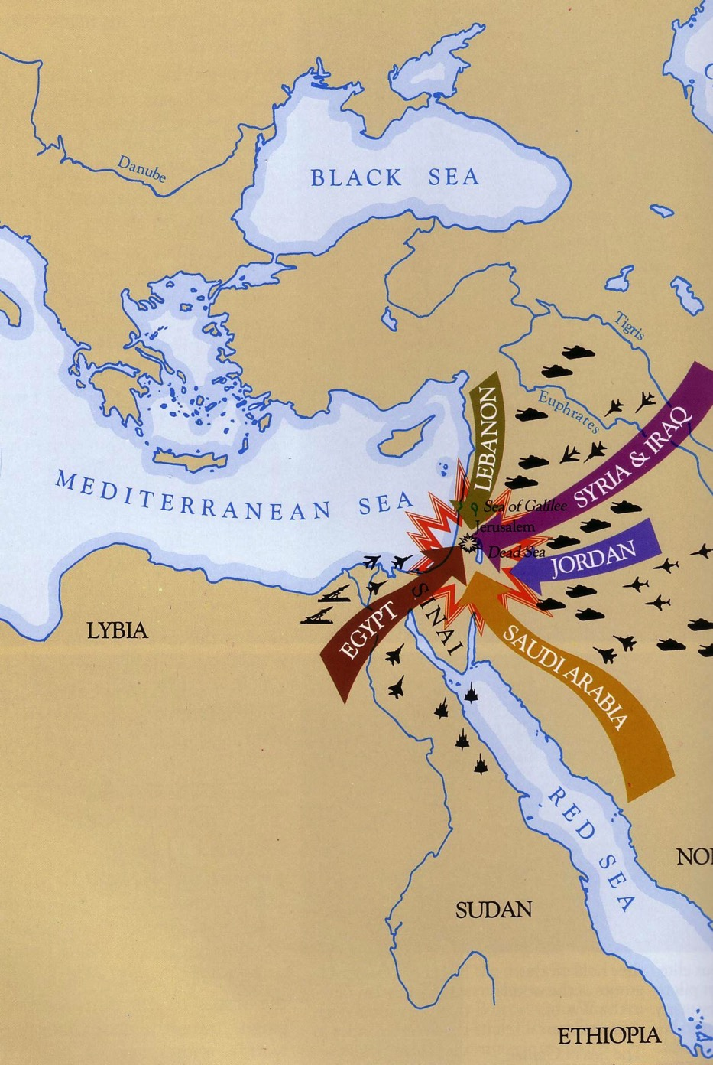
Daniel 11:40
543
Israel's enemies will invade her land

Slide 92
Daniel 11:40-45
Even ships in the Mediterranean will join the battle

Slide 93
West Meets East (Dan. 11:44)

Slide 94
Beasts of Rev. 13
387
Dragon = Satan
Land Beast = False Prophet
Sea Beast = Antichrist
Used with permission

Slide 95
A Satanic "Trinity":
387
"Father" = Satan
"Son" = Antichrist
"Spirit" = False Prophet

Slide 96
The world will worship the beast

Slide 97
The Mark in the Right Hand
He causes all, both small and great, rich and poor, free and slave, to receive a mark on their right hand or on their foreheads, and that no one may buy or sell except one who has the mark or the name of the beast, or the number of his name.
Revelation 13:16-17

Slide 98
"As for us, we can’t help but thank God for you, dear brothers and sisters loved by the Lord. We are always thankful that God chose you to be among the first to experience salvation—a salvation that came through the Spirit who makes you holy and through your belief in the truth. ¹⁴He called you to salvation when we told you the Good News; now you can share in the glory of our Lord Jesus Christ" (2 Thess 2:13-14 NLT).

Slide 99
"With all these things in mind, dear brothers and sisters, stand firm and keep a strong grip on the teaching we passed on to you both in person and by letter. ¹⁶Now may our Lord Jesus Christ himself and God our Father, who loved us and by his grace gave us eternal comfort and a wonderful hope, ¹⁷comfort you and strengthen you in every good thing you do and say" (2 Thess 2:15-17 NLT).

Slide 100
Trusting amidst confusion produces stability
Charles R. Swindoll, Steadfast Christianity, 3
Notes:
There is an immense amount of theological confusion spouted all over today. The rise of the Internet has allowed YouTube and other avenues to spread heresies. It seems that the more hits or likes, the more bizarre and damaging the teaching. My own YouTube video has just a few hundred views, but the insane stuff has millions of views!
How can we keep trusting the Lord amidst such craziness?
Keep going back to the source—the Word of God.
How are you doing at your goal of reading the Bible each day this year?

Slide 101
How does God affirm us when we face tough times?

Slide 102
I. Emotionally: God gives perseverance to bring maturity (2 Thess 1).
Notes:
The Lord helps us not to lose heart so we will grow.

Slide 103
II. Theologically: God gives us truth to bring stability (2 Thess 2).
Notes:
Theology matters! The Lord corrects our misconceptions to give us firm footing.

Slide 104
Slides on 2 Thessalonians 3

Slide 105
Outline of 2 Thessalonians
How God affirms…
Emotions
1
Theology
2
Practice
3
Notes:
III. Practically: God cultivates discipline in us to build responsibility (2 Thess 3).
[The Lord helps us hold one another accountable so we will be reliable.]

Slide 106
III. Practically: God cultivates discipline in us to build responsibility (2 Thess 3).
Notes:
The Lord helps us hold one another accountable so we will be reliable.
• Rather than living an undisciplined life
• Each of us has had to show discipline to learn certain skills such as playing an instrument
• So we need that same type of discipline to know his Word
• And to be a vital part of his church.

Slide 107
"Finally, dear brothers and sisters, we ask you to pray for us. Pray that the Lord’s message will spread rapidly and be honored wherever it goes, just as when it came to you. ²Pray, too, that we will be rescued from wicked and evil people, for not everyone is a believer" (2 Thess 3:1-2 NLT).

Slide 108
"But the Lord is faithful; he will strengthen you and guard you from the evil one. ⁴And we are confident in the Lord that you are doing and will continue to do the things we commanded you. ⁵May the Lord lead your hearts into a full understanding and expression of the love of God and the patient endurance that comes from Christ" (2 Thess 3:3-5 NLT).

Slide 109
"And now, dear brothers and sisters, we give you this command in the name of our Lord Jesus Christ: Stay away from all believers who live idle lives and don’t follow the tradition they received from us. ⁷For you know that you ought to imitate us. We were not idle when we were with you" (2 Thess 3:6-7 NLT).

Slide 110
Discipline the Idle (3:6-15)
"…Stay away from all believers who live idle lives and don't follow the tradition they received from us" (3:6 NLT)

Slide 111
"We never accepted food from anyone without paying for it. We worked hard day and night so we would not be a burden to any of you. ⁹We certainly had the right to ask you to feed us, but we wanted to give you an example to follow" (2 Thess 3:8-9 NLT).

Slide 112
Discipline the Idle (3:6-15)
"…Stay away from all believers who live idle lives and don't follow the tradition they received from us" (3:6 NLT)
"Even while we were with you, we gave you this command: ‘Those unwilling to work will not get to eat’" (3:10 NLT)

Slide 113
"Yet we hear that some of you are living idle lives, refusing to work and meddling in other people’s business. ¹²We command such people and urge them in the name of the Lord Jesus Christ to settle down and work to earn their own living. ¹³As for the rest of you, dear brothers and sisters, never get tired of doing good" (2 Thess 3:11-13 NLT).
“We hear that some among you are idle. They are not busy; they are busybodies” (2 Thess 3:11 NIV).

Slide 114
"Take note of those who refuse to obey what we say in this letter. Stay away from them so they will be ashamed. ¹⁵Don’t think of them as enemies, but warn them as you would a brother or sister" (2 Thess 3:14-15 NLT).

Slide 115
Benediction
Now may the Lord of peace himself give you his peace at all times and in every situation. The Lord be with you all.
2 Thess 3:16 (NLT)

Slide 116
"Here is my greeting in my own handwriting: Paul. I do this in all my letters to prove they are from me. ¹⁸May the grace of our Lord Jesus Christ be with you all" (2 Thess 3:17-18 NLT).

Slide 117
Waiting with discipline cultivates responsibility
Charles R. Swindoll, Steadfast Christianity, 3
Notes:
Hard-working Singapore weeds out lazy people. There is no unemployment insurance here that people can take advantage of, and there is no welfare program that can make people dependent.
However, occasionally we still have people go from church to church to try to get money out of each congregation. Like other churches, we try to have a balanced view where we help people in need—but we also expect our people to work for a living.
Would you say you are a disciplined person?
Do you discipline your time? Or do you waste time?
Do you serve others or spend most of your time on yourself?
The general rule in this passage is Paul’s maxim: “Those unwilling to work will not get to eat” (3:10 NLT).

Slide 118
How does God affirm us when we face tough times?

Slide 119
God affirms holistically (Main Idea of 2 Thessalonians)
How God affirms…
Emotions
1
Theology
2
Practice
3
Notes:
Restated: He is not incomplete or piecemeal in his ministry to us.
• He touches the heart (emotionally),
• the mind (theologically),
• and the hands (practically).

Slide 120
I. Emotionally: God gives perseverance to bring maturity (2 Thess 1).
Notes:
The Lord helps us not to lose heart so we will grow.]

Slide 121
II. Theologically: God gives us truth to bring stability (2 Thess 2).
Notes:
Theology matters! The Lord corrects our misconceptions to give us firm footing.

Slide 122
III. Practically: God cultivates discipline in us to build responsibility (2 Thess 3).
Notes:
The Lord helps us hold one another accountable so we will be reliable.
• Rather than living an undisciplined life
• Each of us has had to show discipline to learn certain skills such as playing an instrument
• So we need that same type of discipline to know his Word
• And to be a vital part of his church.

Slide 123
Words of Affirmation
Notes:
So what can we take home from 2 Thessalonians today?
How are you responding to God’s gentle affirmation during your difficulty?
Are you becoming more mature through perseverance?
Are you growing more stable by growing in truth?
Are you increasing in discipline and responsibility?
How do you affirm others in their tough times so that their trials will make them better instead of bitter?

Slide 124
Sister Mrosla's Third Grade Class St. Mary's School in Morris, Minnesota
Notes:
A Catholic nun named Sister Helen P. Mrosla relates this story about affirmation…
He was in the first third grade class I taught at Saint Mary's School in Morris, Minn. All 34 of my students were dear to me, but Mark Eklund was one in a million. Very neat in appearance, but had that happy-to-be-alive attitude that made even his occasional mischievousness delightful.
___________
Nun's Lesson is Still Viral Decades Later
This story originally appeared in Proteus, A Journal of Ideas, published by Shippensburg University in Pennsylvania. Printed twice a year, each edition of Proteus is devoted to a theme and all its aspects from a number of viewpoints.
In 1991, Sister Helen Mrosla, a former third-grade teacher at our St. Mary's School, responded to the journal's request for stories about education. She submitted the text below. Later that year, Reader's Digest reprinted her submission. About a decade later, the story became a popular email chain letter, which tainted its authenticity. Chain letters are often understood to be hoaxes.
Today, however, this sweet letter has regained its authenticity and is used throughout the world to inspire educators and build students' self-esteem. It's since been republished thousands of times over.
http://assumptionofmorris.org/site/about/ourviralnun/
Accessed 6 Nov 2016

Slide 125
Helen P. Mrosla
Mark Eklund
Notes:
Mark talked incessantly. I had to remind him again and again that talking without permission was not acceptable. What impressed me so much, though, was his sincere response every time I had to correct him for misbehaving: "Thank you for correcting me, Sister!" I didn't know what to make of it at first, but before long I became accustomed to hearing it many times a day.
One morning my patience was growing thin when Mark talked once too often, and then I made a novice teacher's mistake. I looked at him and said, "If you say one more word, I am going to tape your mouth shut!"
It wasn't ten seconds later when Chuck blurted out, "Mark is talking again." I hadn't asked any of the students to help me watch Mark, but since I had stated the punishment in front of the class, I had to act on it.
• I remember the scene as if it had occurred this morning. I walked to my desk, very deliberately opened my drawer and took out a roll of masking tape. Without saying a word, I proceeded to Mark's desk, tore off two pieces of tape and made a big X with them over his mouth. I then returned to the front of the room. As I glanced at Mark to see how he was doing, he winked at me. That did it! I started laughing. The class cheered as I walked back to Mark's desk, removed the tape and shrugged my shoulders. His first words were, "Thank you for correcting me, Sister." At the end of the year I was asked to teach junior high math. The years flew by, and before I knew it Mark was in my classroom again. He was more handsome than ever and just as polite. Since he had to listen carefully to my instructions in the "new math," he did not talk as much in ninth grade as he had in the third.
One Friday, things just didn't feel right. We had worked hard on a new concept all week, and I sensed that the students were frowning, frustrated with themselves — and edgy with one another. I had to stop this crankiness before it got out of hand. So I asked them to list the names of the other students in the room on two sheets of paper, leaving a space between each name. Then I told them to think of the nicest thing they could say about each of their classmates and write it down. It took the remainder of the class period to finish the assignment, and as the students left the room, each one handed me the papers. Charlie smiled. Mark said, "Thank you for teaching me, Sister. Have a good weekend."
That Saturday, I wrote down the name of each student on a separate sheet of paper, and I listed what everyone else had said about that individual. On Monday I gave each student his or her list. Before long, the entire class was smiling. "Really?" I heard whispered. "I never knew that meant anything to anyone!" "I didn't know others liked me so much!" No one ever mentioned those papers in class again. I never knew if they discussed them after class or with their parents, but it didn't matter. The exercise had accomplished its purpose. The students were happy with themselves and one another again.
That group of students moved on. Several years later, after I returned from vacation, my parents met me at the airport. As we were driving home, Mother asked me the usual questions about the trip — the weather, my experiences in general. There was a light lull in the conversation. Mother gave Dad a sideways glance and simply said, "Dad?"
My father cleared his throat as he usually did before something important. "The Eklunds called last night," he began.
"Really?" I said. "I haven't heard from them in years. I wonder how Mark is."
____
Credit: Sister Helen P. Mrosla. Sister Helen Mrosla, a Franciscan nun, submitted "All the Good Things" to Proteus, A Journal of Ideas in 1991. Her article also appeared in Reader's Digest that same year, was reprinted in the original Chicken Soup for the Soul book in 1993, and was offered yet again in 1996's Stories for the Heart.
All The Good Things
Helen P. Mrosla
http://mylifeyoga.com/2015/01/10/all-the-good-things/
Accessed 6 Nov 2016

Slide 126
Mark Eklund
Notes:
Dad responded quietly. "Mark was killed in Vietnam," he said. "The funeral is tomorrow, and his parents would like if it you could attend." To this day I can still point to the exact spot on I-494 where Dad told me about Mark.
I had never seen a serviceman in a military coffin before. Mark looked so handsome, so mature. All I could think at that moment was, Mark, I would give all the masking tape in the world if only you would talk to me.
The church was packed with Mark's friends. Chuck's sister sang "The Battle Hymn of the Republic." Why did it have to rain on the day of the funeral? It was difficult enough at the graveside. The pastor said the usual prayers, and the bugler played taps. One by one those who loved Mark took a last walk by the coffin and sprinkled it with holy water. I was the last one to bless the coffin. As I stood there, one of the soldiers who had acted as pallbearer came up to me. "Were you Mark's math teacher?" he asked. I nodded as I continued to stare at the coffin. "Mark talked about you a lot," he said.
After the funeral, most of Mark's former classmates headed to Chuck's farmhouse for lunch. Mark's mother and father were there, obviously waiting for me. "We want to show you something," his father said, taking a wallet out of his pocket. "They found this on Mark when he was killed. We thought you might recognize it." Opening the billfold, he carefully removed two worn pieces of notebook paper that had obviously been taped, folded and refolded many times. I knew without looking that the papers were the ones on which I had listed all the good things each of Mark's classmates had said about him.
"Thank you so much for doing that," Mark's mother said. "As you can see, Mark treasured it."
Mark's classmates started to gather around us. Charlie smiled rather sheepishly and said, "I still have my list. It's in the top drawer of my desk at home." Chuck's wife said, "Chuck asked me to put his in our wedding album." "I have mine too," Marilyn said. "It's in my diary." Then Vicki, another classmate, reached into her pocketbook, took out her wallet and showed her worn and frazzled list to the group. "I carry this with me at all times," Vicki said without batting an eyelash. "I think we all saved our lists." That's when I finally sat down and cried. I cried for Mark and for all his friends who would never see him again.
_________
"A Morris native and St. Mary's alumni, Mark Eklund was killed in the Vietnam War. He was just 20 years old."
http://assumptionofmorris.org/site/about/ourviralnun/

Slide 127
How ‘bout you?
Notes:
The affirmation you give this week just might meet a specific need and inspire hope too.
Who needs your affirmation this week, today? Take some moments now to tell the Lord who you are going to encourage and how you're going to do it—
Take that person out for a meal?
Offer a helping hand?
Send a card or note?
Phone him or her to show that you care?
Make it simple—but most of all, make it genuine affirmation.
Maybe you need to receive affirmation today more than to give it.
Even if people fail to affirm you, God doesn’t.
He sent his own son for you to affirm you—so tell him thanks!
If you need human affirmation, we are up here to talk afterwards.

Slide 128
Black

Slide 129
NT Preaching • BibleStudyDownloads.org
Get this presentation and script for free!

